Slide 1
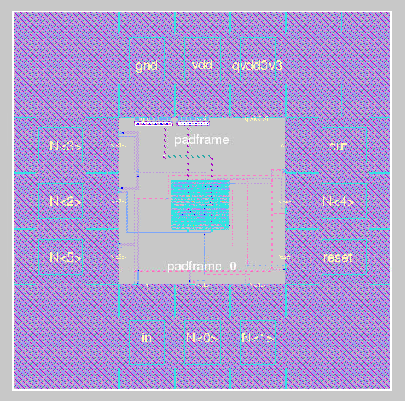
VSDOpen Conference 2018
Padframe Generator for RTL2GDS flow
Philipp Gühring pg@futureware.at
www.vlsisystemdesign.com
13.10.2018

Slide 2
VSDOpen Conference 2018
Abstract
How to use it
Future goals
www.vlsisystemdesign.com
13.10.2018

Slide 3
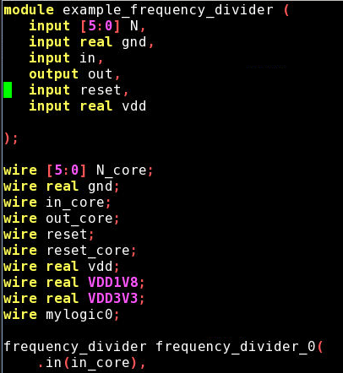
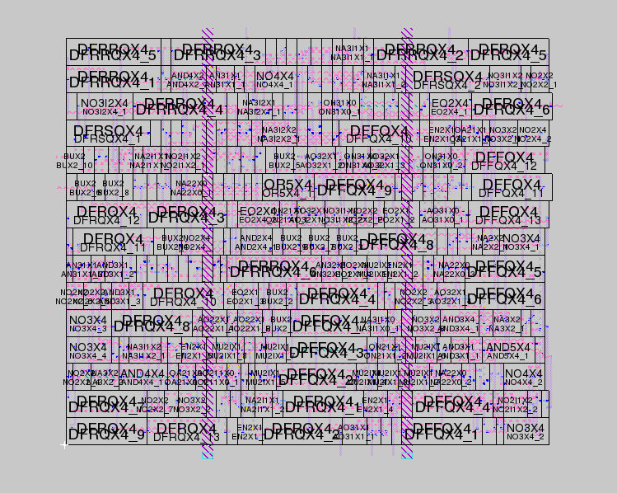
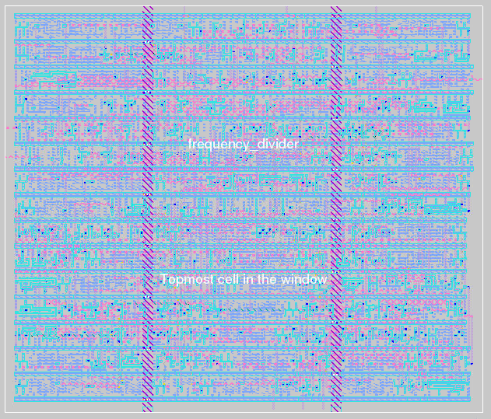
VSDOpen Conference 2018
First steps
Login on www.efabless.com
Write your code in Verilog
Generate a die in Qflow
Yosys
Graywolf
Qrouter
Vesta
magic
www.vlsisystemdesign.com
13.10.2018

Slide 4
VSDOpen Conference 2018
First steps
Login on www.efabless.com
Write your code in Verilog
Generate a die in Qflow
Yosys
Graywolf
Qrouter
Vesta
magic
www.vlsisystemdesign.com
13.10.2018

Slide 5
VSDOpen Conference 2018
First steps
Login on www.efabless.com
Write your code in Verilog
Generate a die in Qflow
Yosys
Graywolf
Qrouter
Vesta
magic
www.vlsisystemdesign.com
13.10.2018

Slide 6
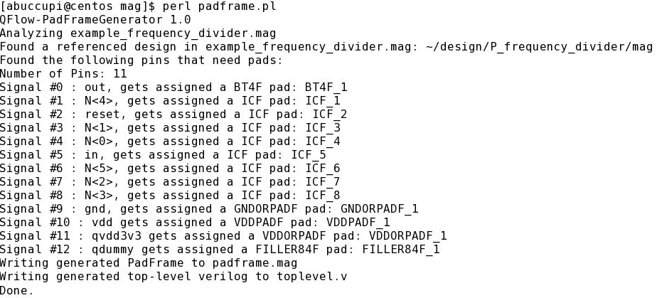
VSDOpen Conference 2018
Generate the Padframe:
www.vlsisystemdesign.com
13.10.2018

Slide 7
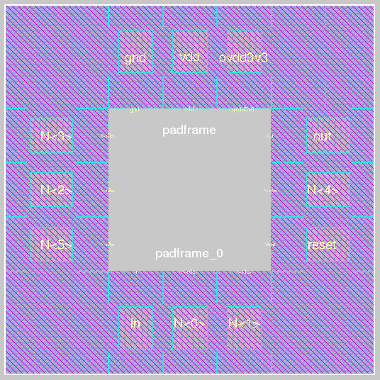
VSDOpen Conference 2018
Generated
Padframe:
padframe.mag
www.vlsisystemdesign.com
13.10.2018

Slide 8
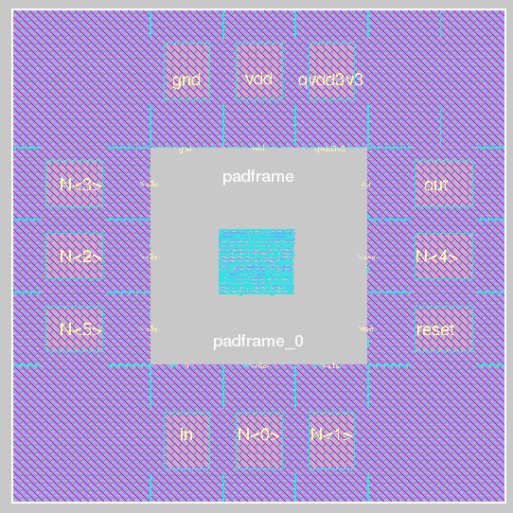
VSDOpen Conference 2018
Combine
Both in
magic:
www.vlsisystemdesign.com
13.10.2018

Slide 9
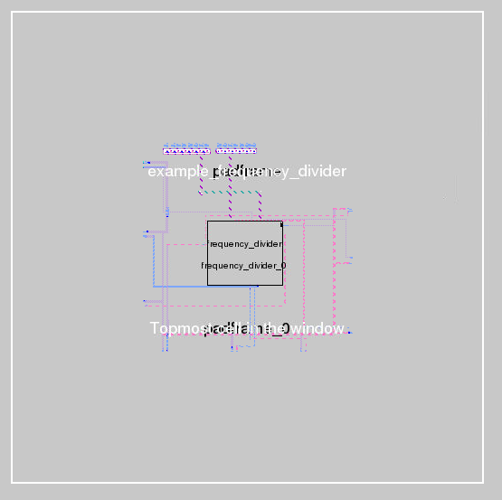
VSDOpen Conference 2018
manual
Toplevel
Routing:
www.vlsisystemdesign.com
13.10.2018

Slide 10
VSDOpen Conference 2018
Completed
Chip:
www.vlsisystemdesign.com
13.10.2018

Slide 11
VSDOpen Conference 2018
Automatic mapping of pad types:
signal name mapping
Padname | XH018 | Verilog | Description
QVDD3V3 | VDDORPADF | input real | 3.3V core voltage
VDD | VDDPADF | input real | 1.8V core voltage
VCC | VDDIPADF | input real | Supply voltage
GND | GNDORPADF | input real | 0V ground
RESET, RST, INPUT | ICF | input | reset signal input
OUT | BT4F | output | Output signals
GPIO | BBCUD4F | inout | GPIOs
www.vlsisystemdesign.com
13.10.2018

Slide 12
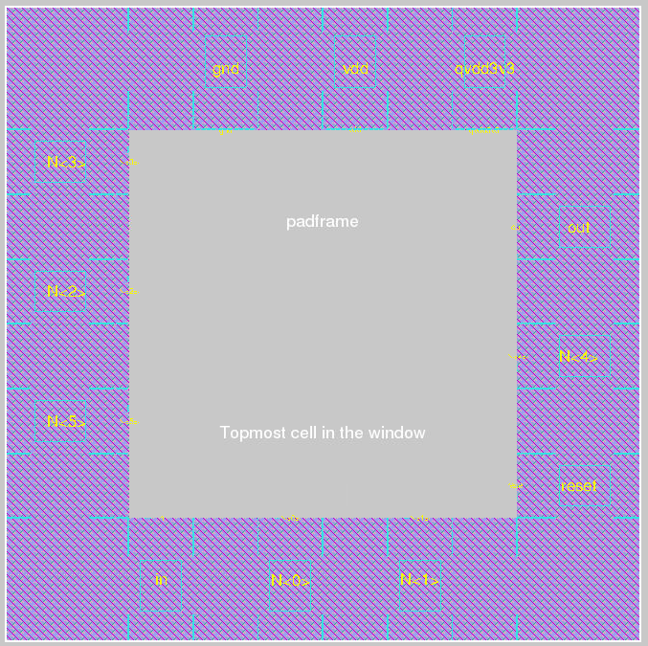
VSDOpen Conference 2018
For A larger
Padframe
Add fillers:
www.vlsisystemdesign.com
13.10.2018

Slide 13
VSDOpen Conference 2018
Future Ideas:
Enhancing the padframe generator to generate padframes for multiple cores inside the chip
Capability to let the user influence the positioning/order of the pads
make guesses which pads are necessary for the signals overridable
Automatically derive the amount of necessary filler pads for the size of the core so that there is enough space inside the padframe for the core
Adaptation to other cell libraries / process nodes
www.vlsisystemdesign.com
13.10.2018

Slide 14
VSDOpen Conference 2018
Crowdfunding campaign:
Target: OpenSource PDK (Process Design Kit)
Mixed-Signal, ~ 65-180 nm
Will be launched soon:
http://www.futureware.at/CrowdFunding/OpenPDK
www.vlsisystemdesign.com
13.10.2018

Slide 15
VSDOpen Conference 2018
Q & A
www.vlsisystemdesign.com
13.10.2018

